Slide 1
Tracko Planning

Slide 2
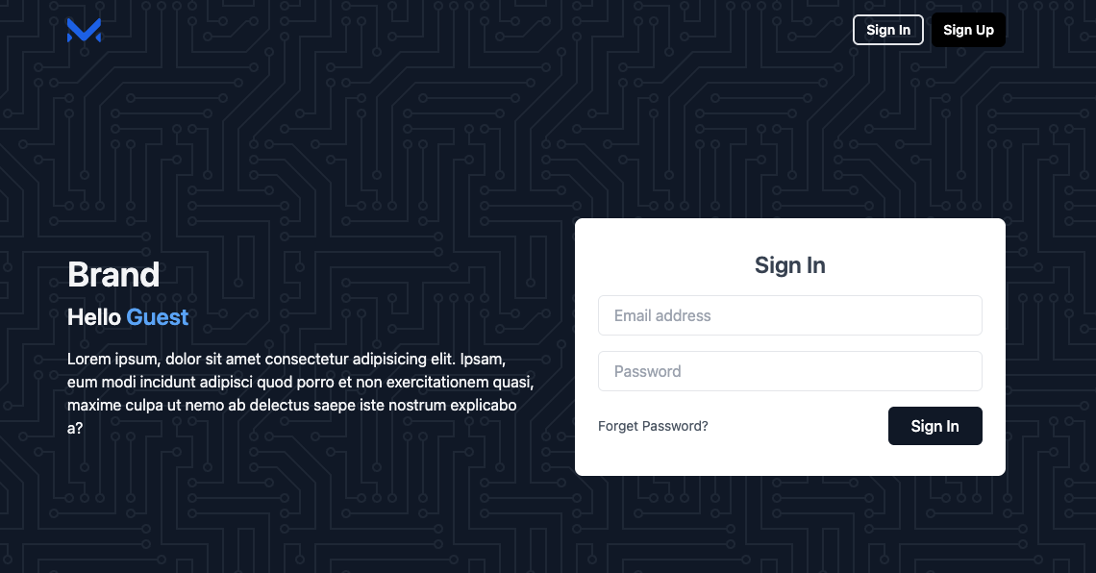
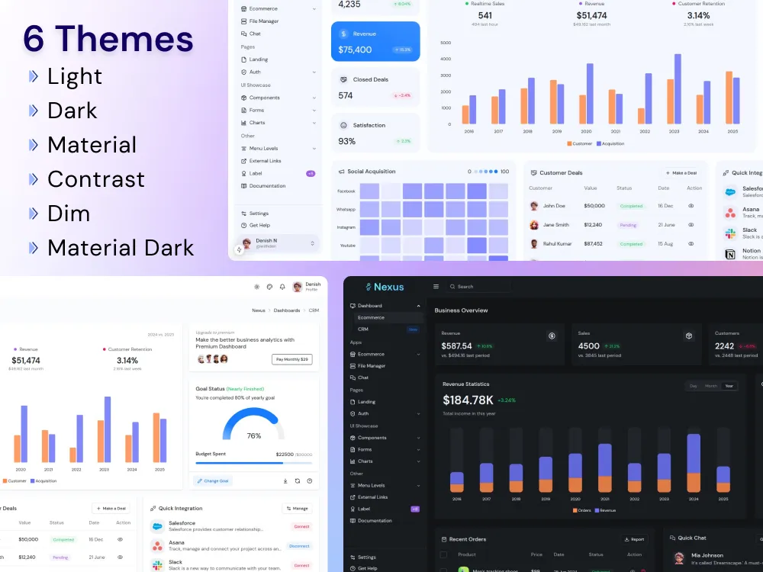
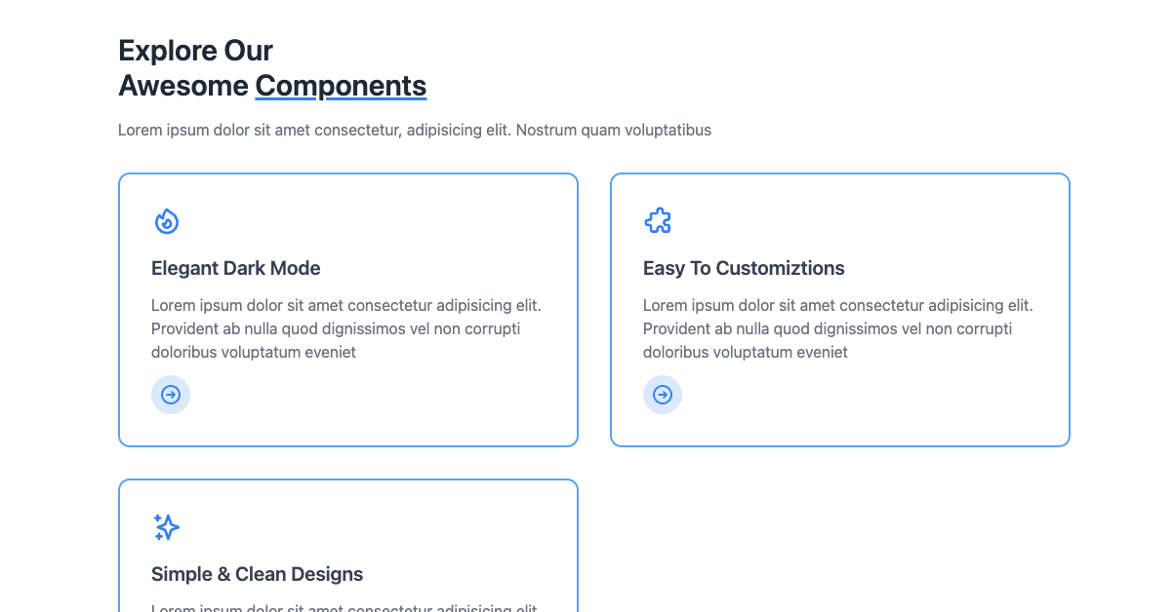
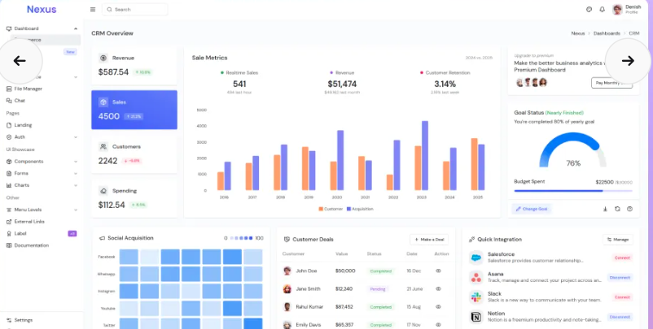
Adjust income
Upload new csv
Months - scroll
Upload new csv
Adjust income, dynamic pie chart animation

Slide 3

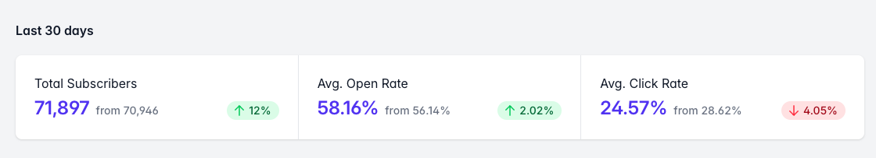
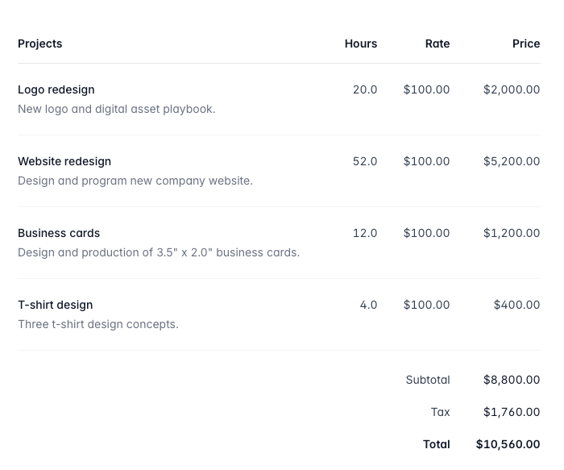
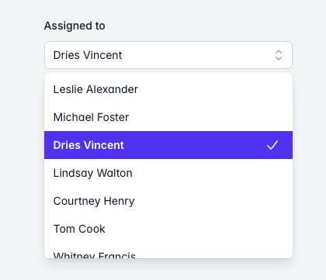
Upload new csv section
Month Summaries
Expense lists
Change graph toggle to dropdown

Slide 4

7209b7
4361ee
f72585
4cc9f0
560bad
7209b7
b5179e
f72585

Slide 5






